Slide 1
Name: Swapnil Ghosh
Roll: 001911001067
Dept: IT
Group: A2
TASK 4

Slide 2
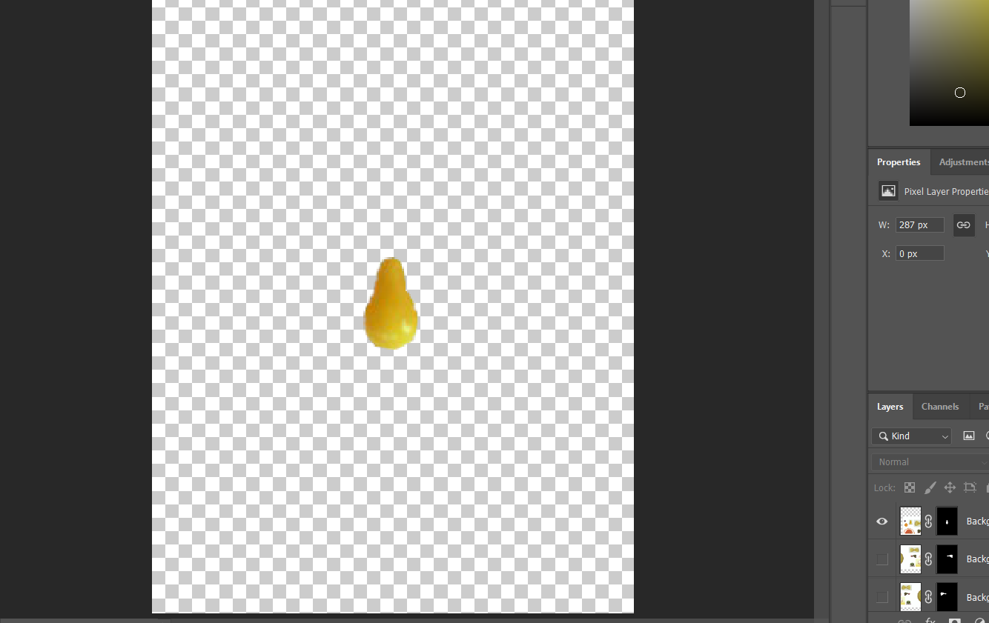
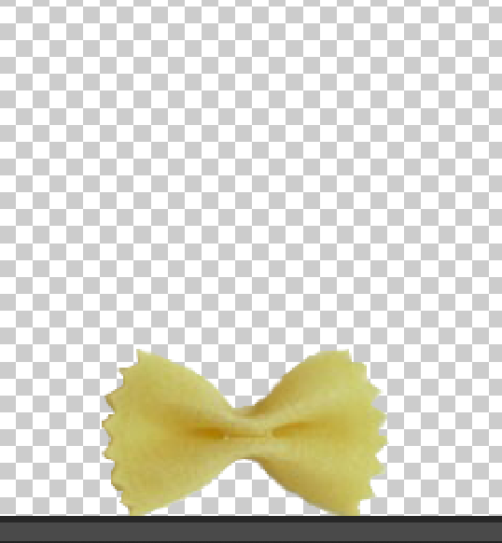
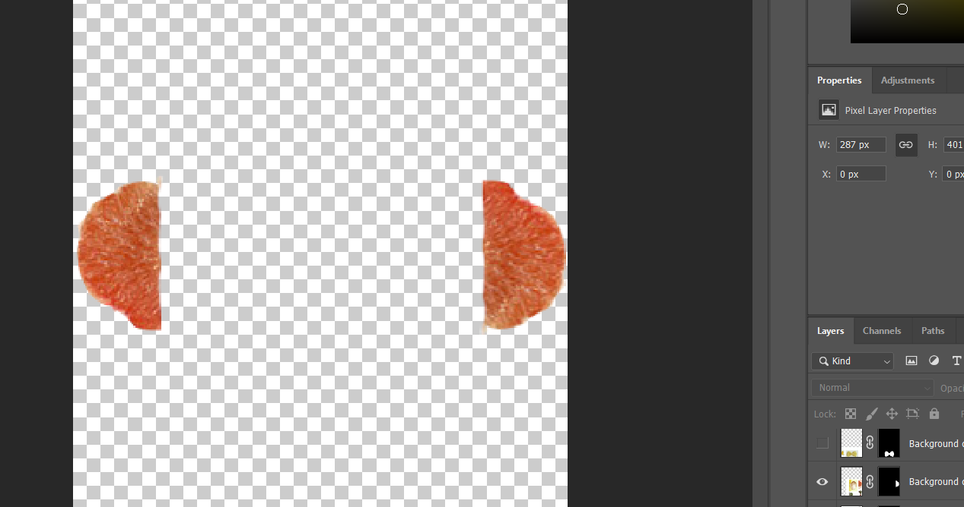
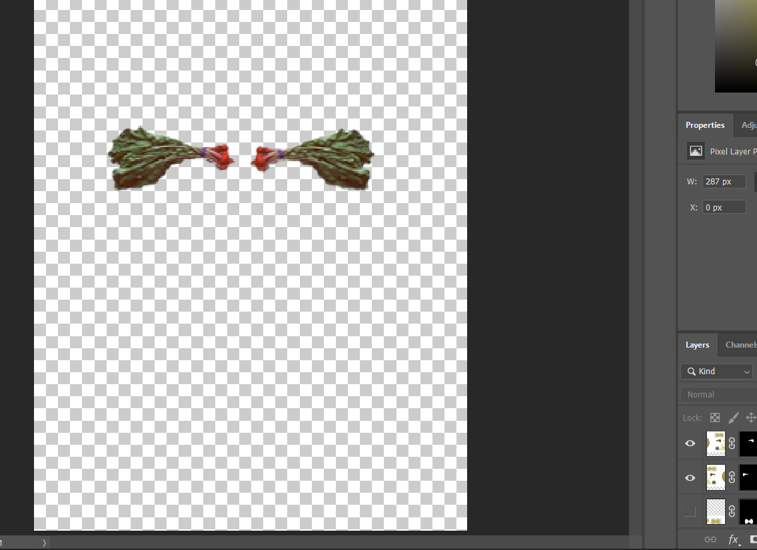
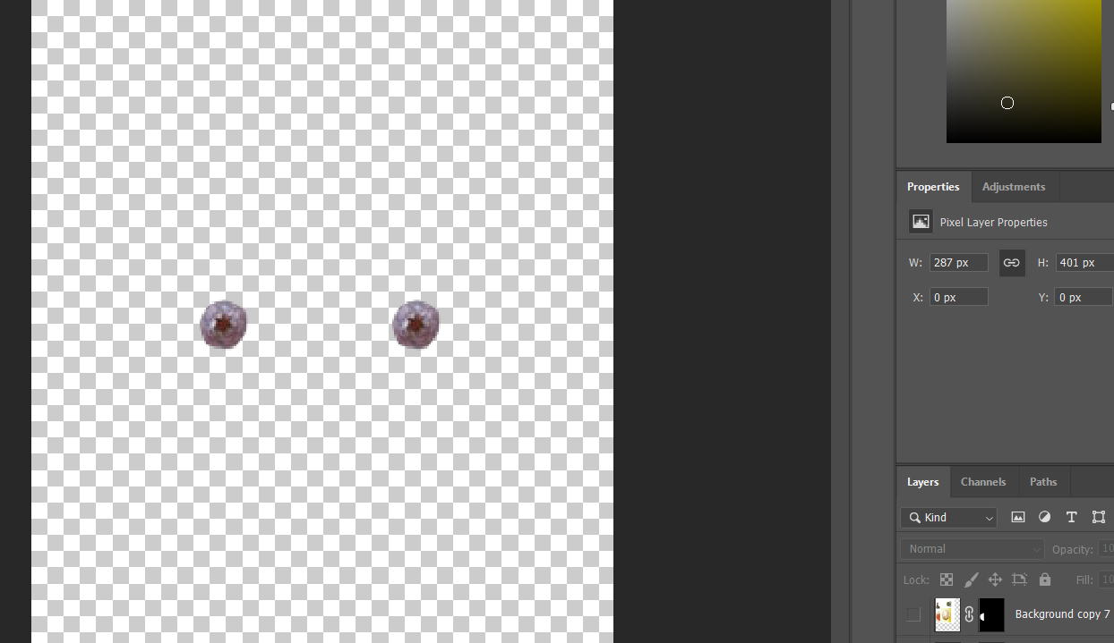
Step-1) Opened the VEG.PSD file in Photoshop
Step -2) Used Elliptical Marquee tool, to make the selection for Every Object in the Image.
Step -3) And masked then out using layer mask.(because my keyboard was showing some error in deleting the deletion and paste it in another layer) and repeated this process for every object till every item is isolated.
Step -4) Duplicated some layer and used Edit > Free Transform to rotate , flip and resize the image.

Slide 3
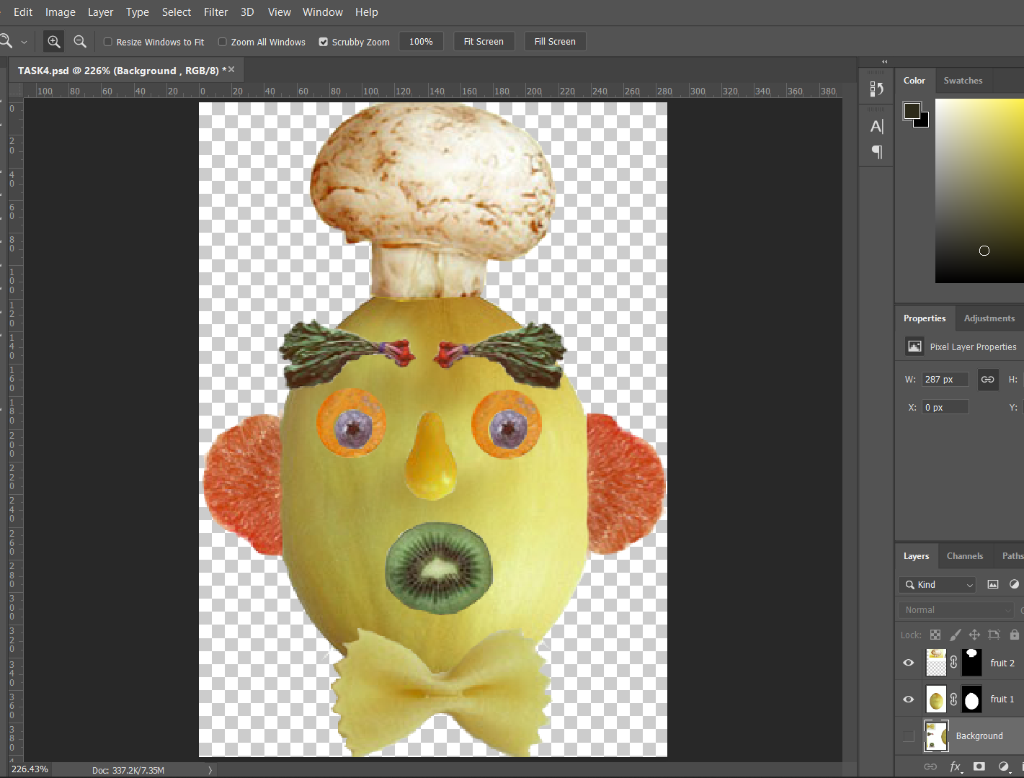
Step-5) Merged All Layer One above each other to make the Final image

